Slide 1

BIDIRECTIONAL PERSON COUNTER
MATHEMATICAL ENGINEERING
GRADUATION THESİS
MATHEMATİCAL ENGINEERING
GRADUATION THESİS
GRADUATION THESIS MANAGER : ASSOC. PROF. FATMA AYDIN AKGÜN
MELİH OĞUZALP
15058007

Slide 2

CONTENTS
INTRODUCTION
WHAT IS IOT ?
WHAT IS ARDUINO ?
LIST OF COMPONENTS
ADJUSTABLE INFRARED SENSOR
ESP8266 WIFI MODULE
IMPLEMENTATION OF ARDUINO
WHAT IS THINGSPEAK ?
IMPLEMENTATION OF THINGSPEAK
WHAT IS ANDROID STUDIO ?
IMPLEMENTATION OF ANDROID
CONCLUSION

Slide 3

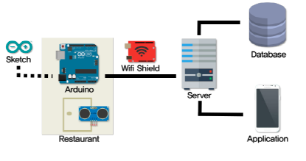
INTRODUCTION
Called BPC
Arduino, Server and Android Studio
Using in many areas (stores, companies etc.)

Slide 4
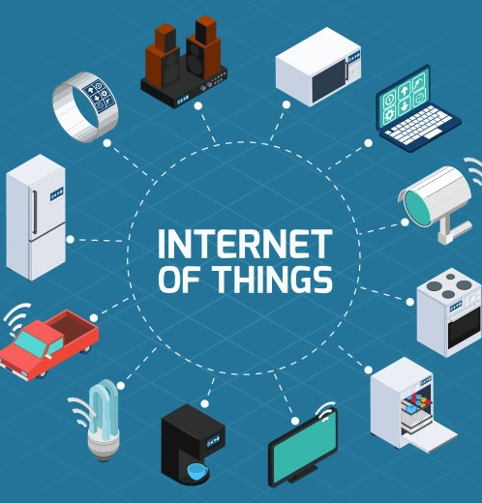
WHAT IS IoT ?
Connected to the Internet
Communicate with people and other things
Transfer data

Slide 5

WHAT IS ARDUINO ?
Open-source electronics platform
Based on easy-to-use hardware and software
Reads sensor values

Slide 6
LIST OF ARDUINO COMPONENTS
Arduino Mega
MZ80 Adjustable Infrared Sensor X 2
ESP8266 Wi-Fi Module
Breadboard
Jumper Cables

Slide 7

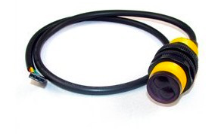
MZ80 Adjustable Infrared Sensor
Measures the distance
Specifications:
Power supply: 5V
Working Current: <100mA,
Adjustable detection range: 3cm - 80cm

Slide 8
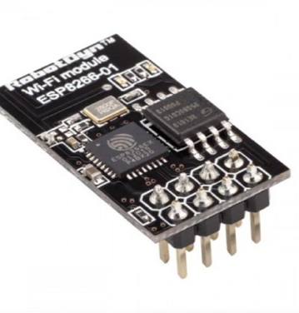
ESP8266 Wi-Fi Module
Connecting Internet
Specifications:
GND,GPO2,GPO0,RX,TX,CH_PD,REST,VCC
Powered by 3.3V

Slide 9
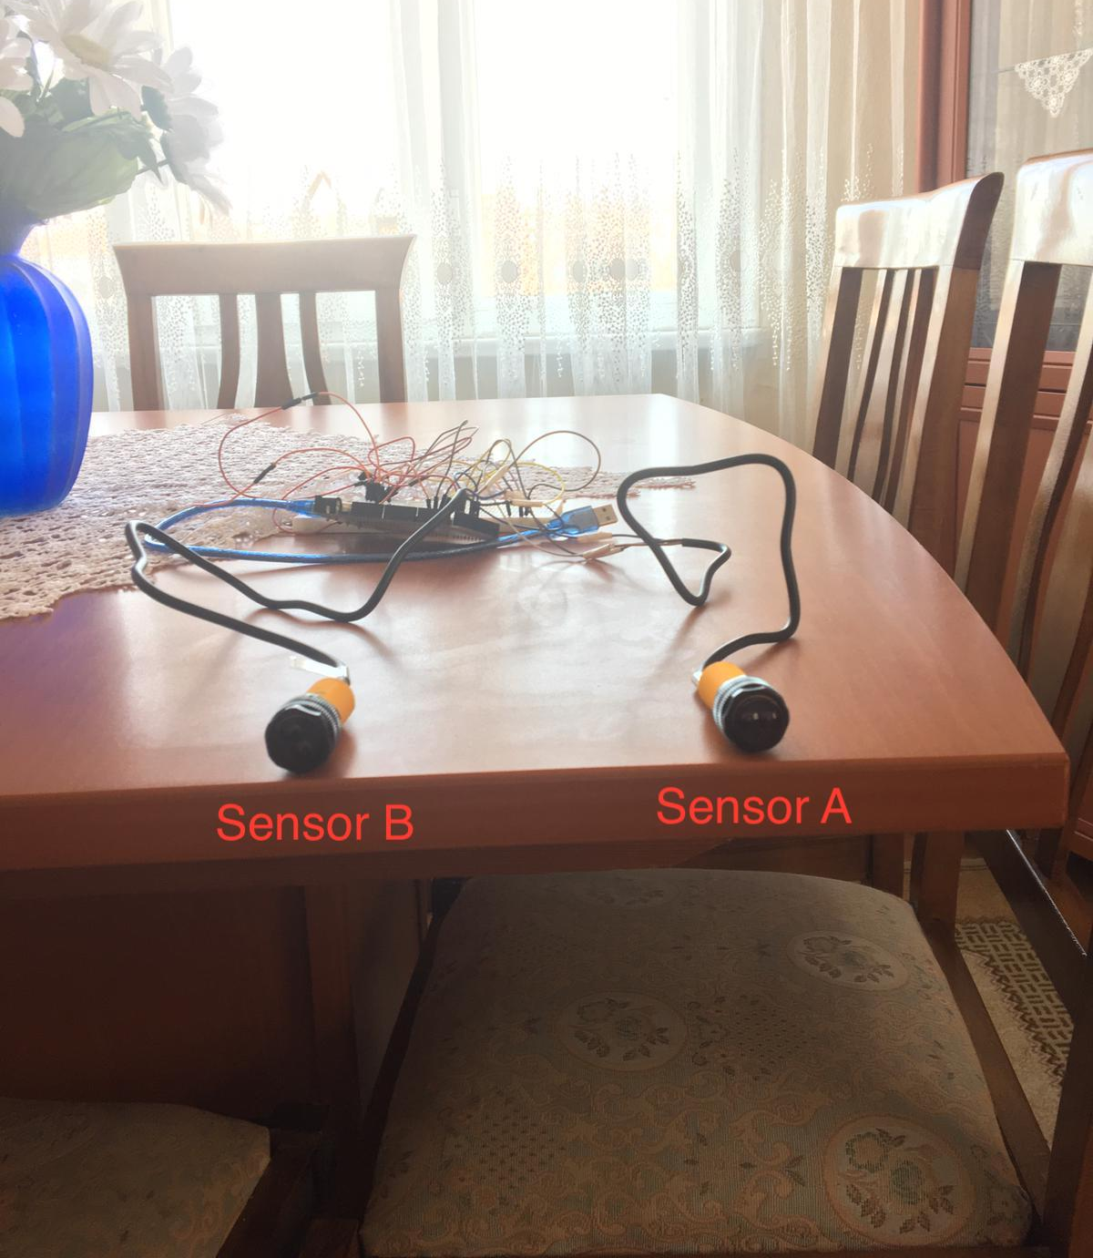
IMPLEMENTATION OF ARDUINO
Take values from sensors
Count the number of people entering and leaving.

Slide 10
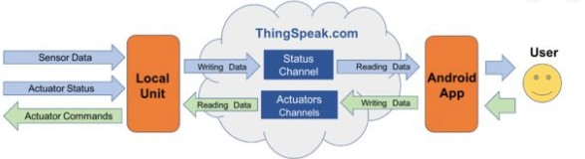
WHAT IS THINGSPEAK ?
Open data platform for the IoT
Analyze the data

Slide 11
Implementation of ThingSpeak
Connect to the internet
Create an account
Analyze the data via graphs
Data are sent to server.

Slide 12
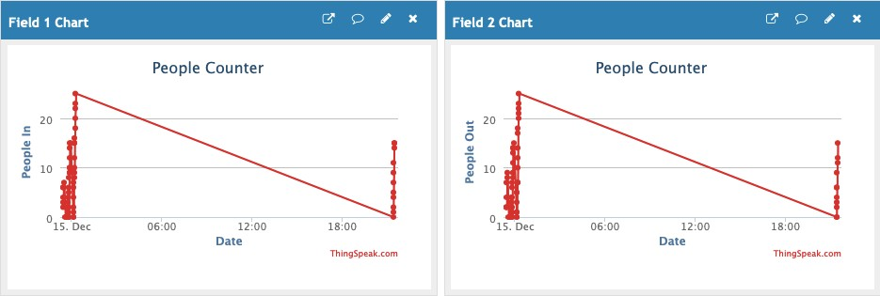

Slide 13

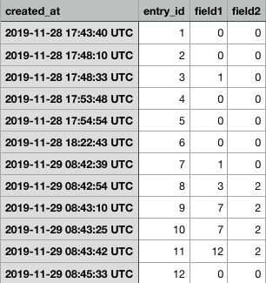

Slide 14
WHAT IS ANDROID STUDIO ?
Google’s platform
Creating android app
Components:
Code templates
Emulator
GitHub integration
Gradle-based build system

Slide 15
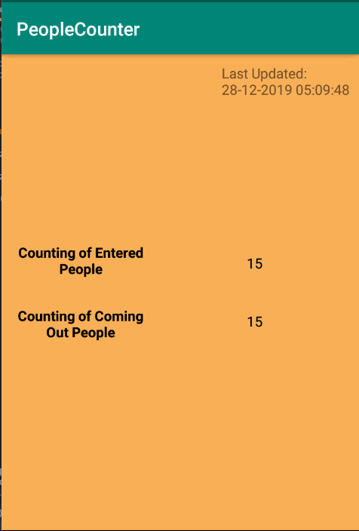
IMPLEMENTATION OF ANDROID

Slide 16
CONCLUSION
Discussed BPC in this study
Explained and applied some methods
Adding more features

Slide 17

THANK YOU FOR LISTENING TO ME

